Slide 1
FACILITIES
SERVICES
RESOURCE CONSERVATION PROGRAM UPDATE
January 3, 2017
Presented by James A. Angelosante
Executive Director, FS Chief Financial Officer
Finance and Business Services (FABS)
Facilities Services

Slide 3
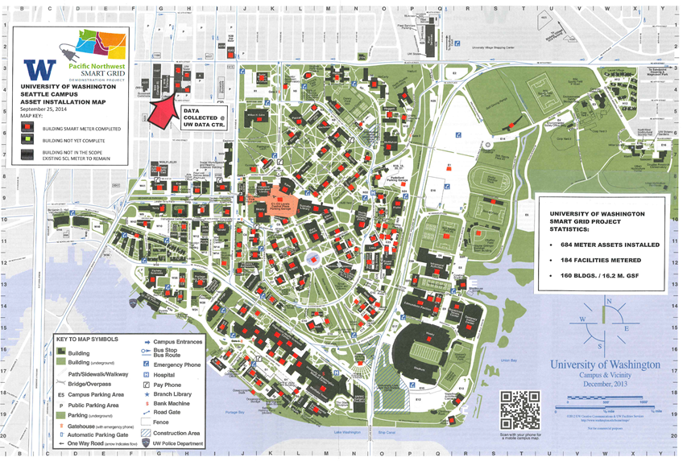
BACKGROUND
PACIFIC NORTHWEST SMART GRID DEMO PROJECT
$10.2 Match Grant Project
PNNL Prime & DOE ARRA Sponsored
ENERGY DASHBOARD
http://dashboard.mckinstry.com/uw/

Slide 4
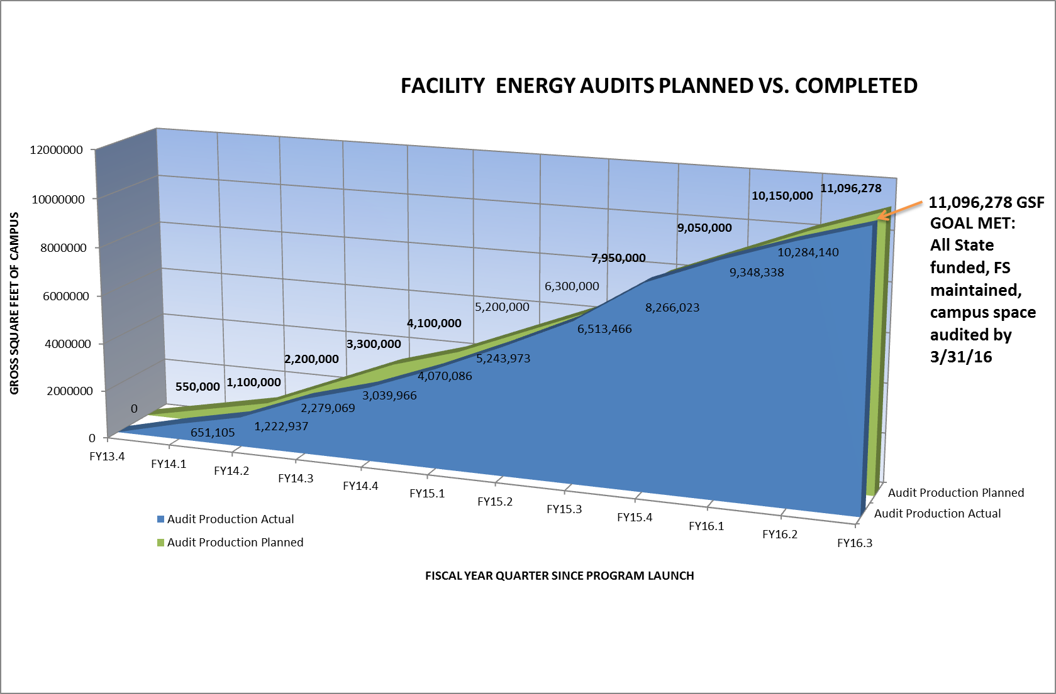
PLAN
RESOURCE CONSERVATION PROGRAM
Formalized 2013
STAFFING
(1) Resource Conservation Manager
(2) Energy Engineers
(1) Project Manager
ENERGY AUDITS
11 million gross square feet, 100% completed
417 RCMs identified
$22.7 million project cost required
$7.8 utility incentive potential
$4.4 million annual utility cost avoidance
30,285 Mg CO2e avoidance possible
AUDIT PRODUCTION PLANNED V. ACTUAL
Notes:
LEVERAGING SMART METER DATA
Build upon PNWSGD Project
Flipped the ESCO relationship
Spotlights: fact based decision making

Slide 5
PROGRAM
RCMS BUNDLED INTO 8 PROJECT TYPES
Builds Self Perform Capacity
Outsourced work minimized
FACT BASED CRITERIA
Lifetime savings/investment = ROI
ROI always greater than 1:1
Rebate capture/investment: $1m/biennium
Carbon avoidance: 15% by 2020
BENEFITS OF IMPLEMENTATION
Improve facility operators competencies and job satisfaction
Optimize building user comfort and productivity
Reduce fixed cost overhead: $3.22 lifetime return on each $1 invested

Slide 6
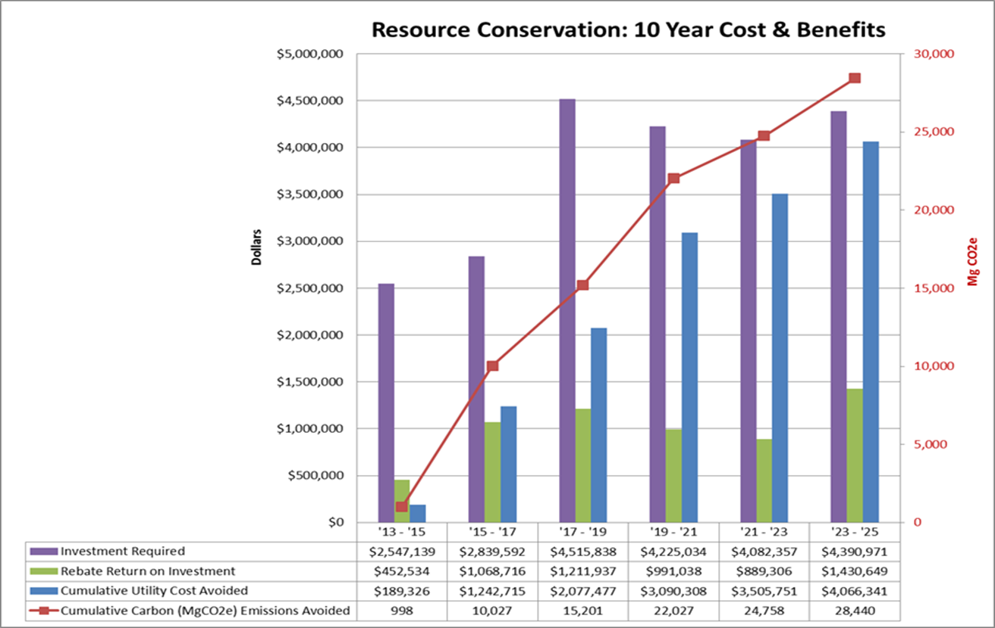
BUDGET
FY 12 to FY15:
+ 375% in program funding
15-17 Biennium Investments:
83 RCMs in 22 Projects
Green Revolving Fund:
(current status: 11/1/2016)
Biennial Allocation $1.9m
Rebate Reserves $1.0m
Program Priorities:
Rebate rich projects
Carbon rich projects
Self perform
Minor Cap. Overlap
Max. ROI
July 2020 UW CARBON AVOIDANCE TARGET:
Reduce Scope 1 & 2 Carbon Emissions by 16,934 MgCO2e (15% of 112,890 MgCO2e)
Actual Cumulative Carbon (MgCO2e) Emissions Avoided | 1,828 | 4,139
In Progress Project Carbon (MgCO2e) Emissions Avoided |  | 5,972
TOTAL Cumulative Carbon (MgCO2e) Emissions Avoided |  | 10,111

Slide 7
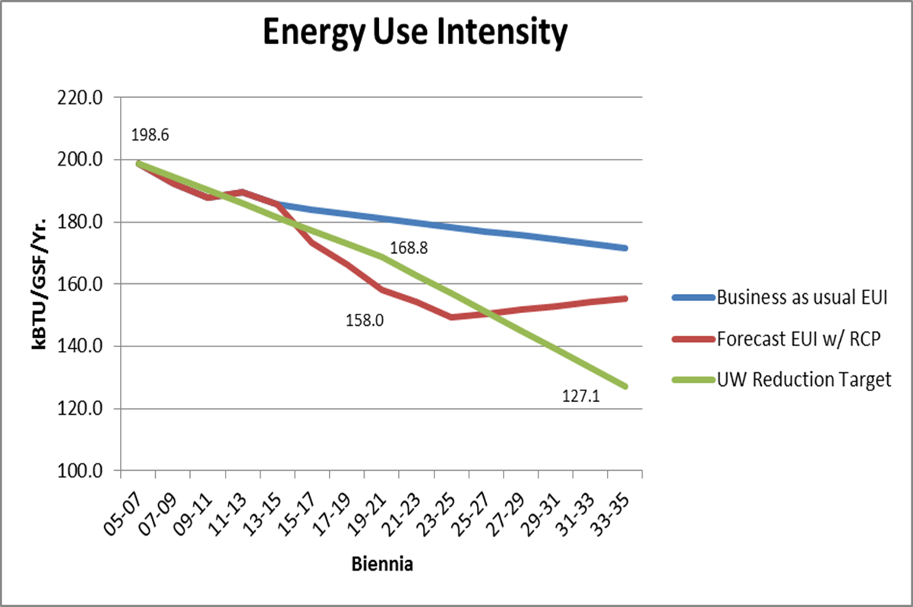
ENVIRONMENTAL OUTCOMES
POLICY & CODE COMPLIANCE
ACUPCC & Washington State targets:
15% below 2005 levels by 2020
36% below 2005 levels by 2035
OPTIMIZED PHYSICAL PLANT
Increased facility life
Reduced maintenance backlog
Improves FS staff satisfaction
HIGHER LEVEL OF SERVICE, CUSTOMER SATISFACTION
Fewer trouble calls
Greater level of comfort, higher productivity
Enhanced utility relationships and communication
< Target: 2020 = 15% below 2005

Slide 8
COST EFFECTIVE SERVICES
Return on investment of Resource Conservation Program projects completed by fiscal quarter.
Metric and target widely accepted by stakeholders and process partners.
Acceptance led to institutional focus, rigor and improved performance over time.
Resource Conservation Projects | FY15.1-FY17.1
Utility Cost Avoided -Life | $3,782,013
Gross Investment | $3,391,532
Rebates/Grants | $1,905,738
Net Capital Investment | $1,485,794
Return on Investment | 2.55
Carbon Avoided (MgCo2e/Yr) | 3,724

Slide 9
QUESTIONS
Norm Menter
Manager
Resource Conservation Program

