Slide 1
UW in the High School
An annual campus process goes paperless
Tim Stetter Emily Edmiston
Director Program Administrator

Slide 2
How the Program Works
Administered by UW Educational Outreach
Highly qualified high school teachers
Approved, trained, and supported by UW departments
Teach UW courses in the high school
Eligible students can register to earn UW credit
Notes:
5

Slide 3
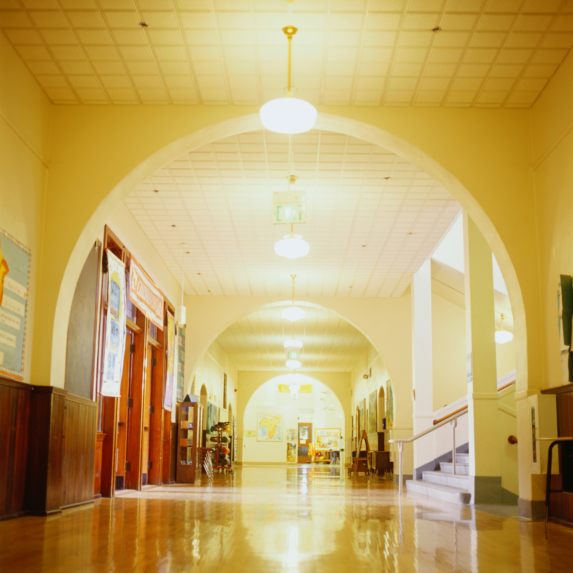
Program Highlights
Oldest “College in the High School” program in Washington (1981)
19 departments on campus
100+ high schools
200+ teachers
4,000+ students
Notes:
5

Slide 4
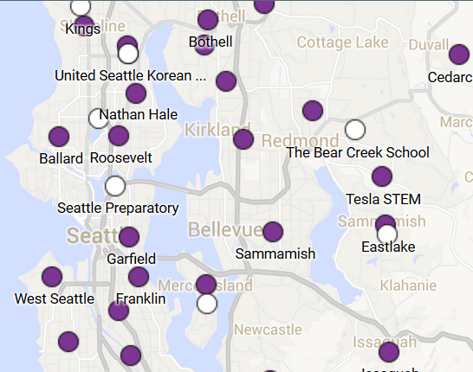
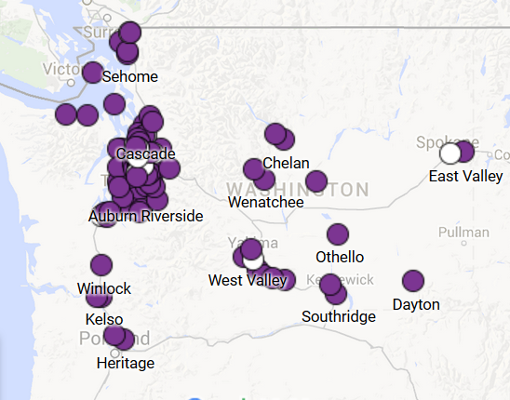
High School Partnerships

Slide 5
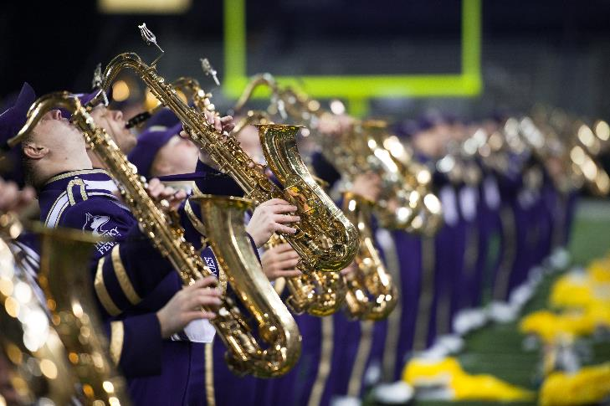
Campus Partnerships
College of Arts & Sciences
College of Engineering
College of the Environment
Department of Global Health
Academic oversight, including sponsorship of courses
course approval process…

Slide 6
Old Way: Course Approval Process
Courses approved via course approval packet, signed by Chair and Dean
Each packet contained:
EO internal checklist
Approval form for signatures and routing
Memo to Chairs and Deans
Copy of instructor resume for Chair
Copy of instructor resume for Dean
Copy of end-of-course evaluation for Chair
Copy of end-of-course evaluation for Dean

Slide 7
Rethinking the Process
What is the goal of the course approval process?
Can this goal be met in other ways?
Consider broader context of program
New paperless option that streamlines process (even more than pdf approvals)
Approval of proposed process within EO
Paper reduction and staff time efficiency
Meetings, emails with other units
Communication to Chairs and Deans, plus UWHS Coordinators in each department

Slide 8
New Way: Course Update Process
Email update to Chairs and Deans (Spring and Autumn)
Spreadsheet of courses
For Chairs only: pdf of resumes of any new teachers
No course evaluations
No signatures
No campus mail or routing
No paper!

Slide 9
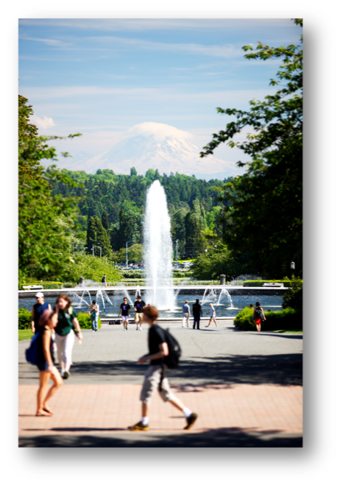
Paper Reduction
Course Approval Process:
Average # pages/packet = 9
X
Approximate # packets = 350
=
3,150 pages
6 reams of 500 sheets
stack of paper 1 foot tall

Slide 10
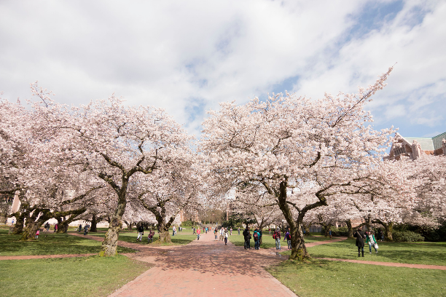
Feedback from campus partners
“Makes sense”
Rich Watts, Chair of French
[Thanks for] “making our lives much simpler.”
Brian Reed, Chair of English
“Seems smart to me.”
Kevin Mihata, Associate Dean of Arts & Sciences
Internally at EO, this change was applauded by all involved (or formerly involved).

Slide 11
Other UWHS Processes
The good (i.e. paperless or nearly so)
Teacher applications
School district contracts *
The bad (i.e. paperful)
Student end-of-course evaluations
Student registration

Slide 12
UW in the High School
An annual campus process goes paperless
uwhs@pce.uw.edu
www.uwhs.washington.edu

